Slide 1
CS5187: Vision & Image
Zhu Zhiyu
Tutorial 03: Feature Detection
Notes:
How about now?

Slide 2
（1）Implementing the Harris Corner Response
Objective: Manually compute the Harris response function to identify interest points.
Experiment:
Compute image derivatives $I_x$ and $I_y$ using Sobel filters.
Construct the second moment matrix $H$ by computing the weighted sums of $I_x^2$, $I_y^2$, and $I_x I_y$ using a Gaussian window.
Calculate the cornerness score $R = \det(H) - k \cdot (\text{trace}(H))^2$ for each pixel.
Visualization: Display the $R$ values as a heatmap where red represents high cornerness and blue represents low cornerness.
Notes:
First, we should talk about what an image is.

Slide 3
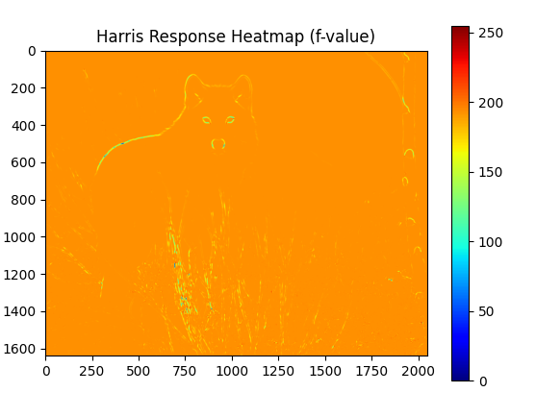
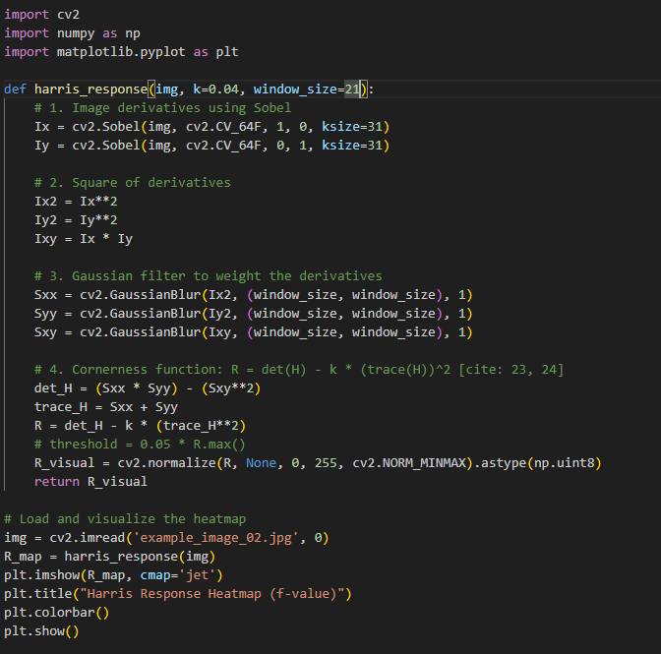
（1）Implementing the Harris Corner Response
Notes:
First, we should talk about what an image is.

Slide 4
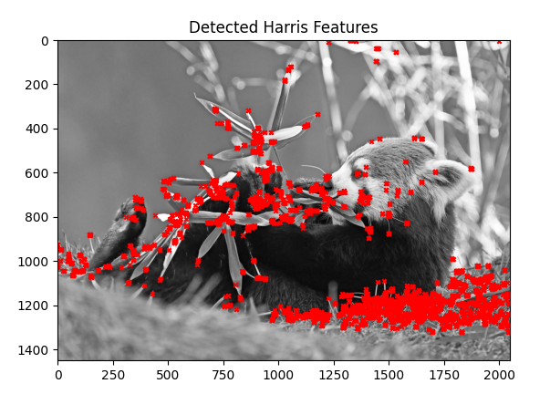
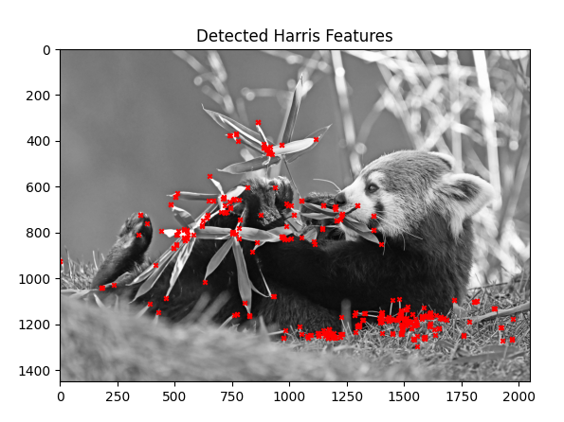
（2）Non-Maximum Suppression (NMS) and
Thresholding
Notes:
First, we should talk about what an image is.

Slide 5
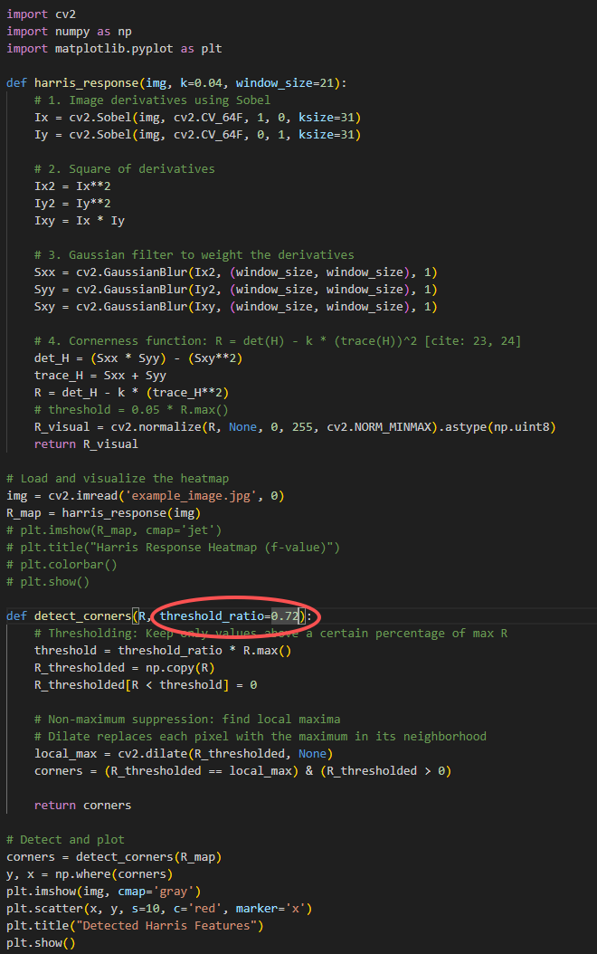
（2）Non-Maximum Suppression (NMS) and
Thresholding
You can change the ratio
Notes:
First, we should talk about what an image is.

Slide 6
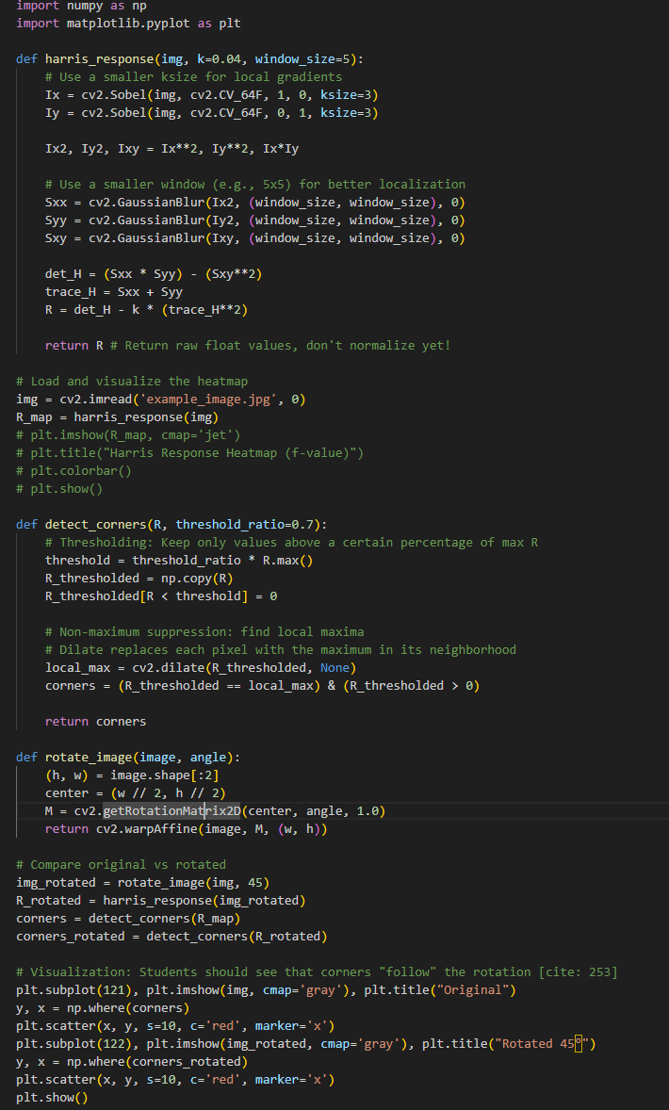
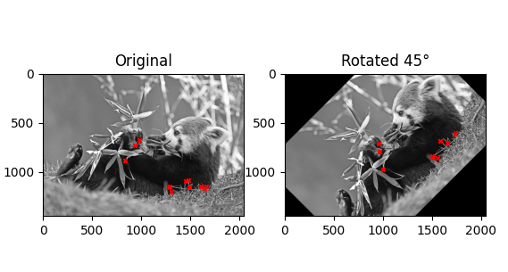
（3）Invariance Testing: Rotation
Notes:
First, we should talk about what an image is.

Slide 7
Questions?

